Slide 1
Three Circles and a Tangent

Slide 2
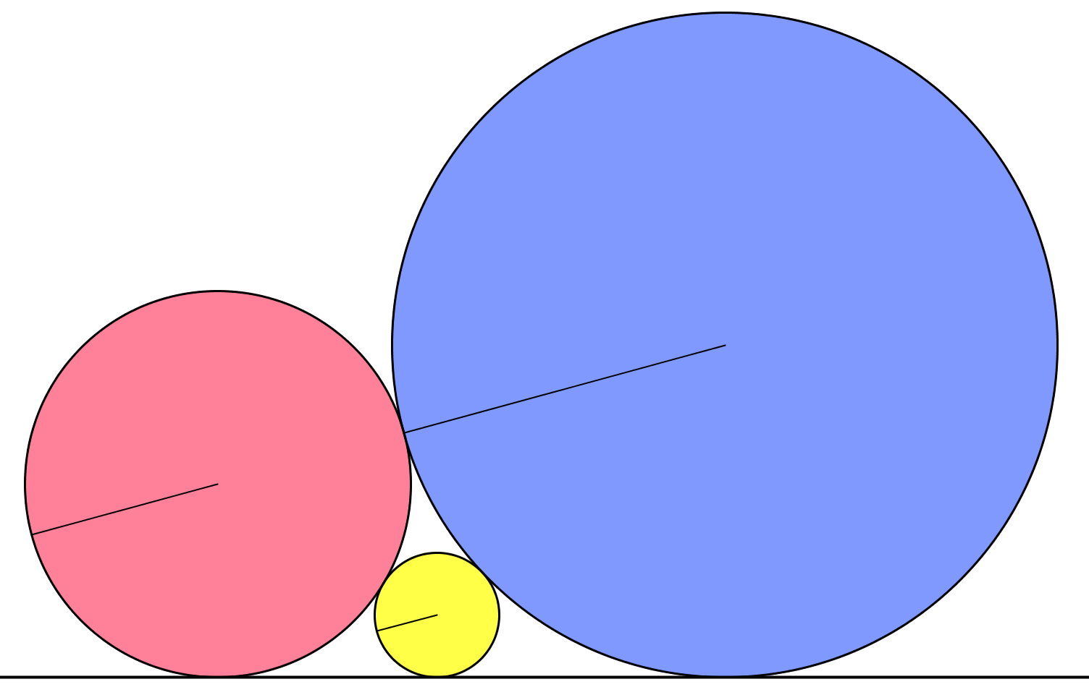



Three Circles and a Tangent
The three circles are touching and share a common tangent.
The radii of the two larger circles are as stated in the diagram
- all units are cm.
$$144$$
$16$
(Not to scale)
$$a$$
What is the value of the radius of the smallest circle, $a$?

Slide 3
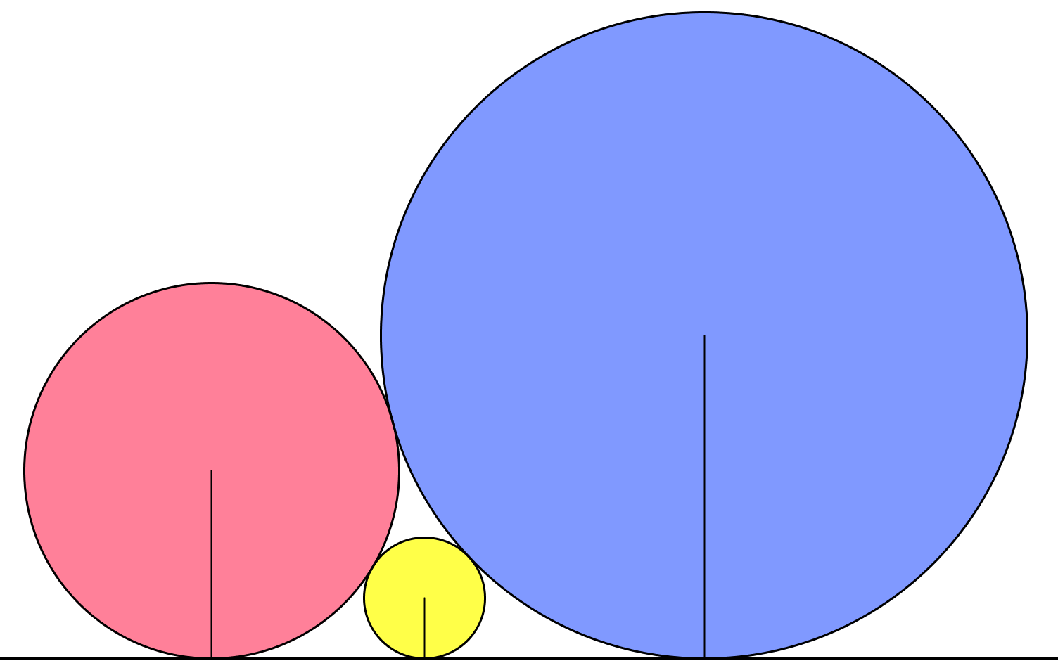





Three Circles and a Tangent
$$c$$
$$b+a$$
$$b−a$$
$$b$$
$$a$$

Slide 4


Three Circles and a Tangent
$$c+a$$
$$c−a$$
$$b$$
$$a$$

Slide 5


Three Circles and a Tangent
$$b+c$$
$$c−b$$
$$c$$
$$b$$
$$a$$

Slide 6


Three Circles and a Tangent
$$b+c$$
$$c−b$$
$$c+a$$
$$c−a$$
$$b+a$$
$$b−a$$

Slide 7






Three Circles and a Tangent
$$b+c$$
$$c−b$$
$$\sqrt{{\left(b+c\right)}^{2}−{\left(c−b\right)}^{2}}=2\sqrt{bc}$$
$$2\sqrt{bc}=2\sqrt{ab}+2\sqrt{ac}$$
$$c+a$$
$$c−a$$
$$b+a$$
$$b−a$$
$$2\sqrt{ab}$$
$$2\sqrt{ac}$$

Slide 8
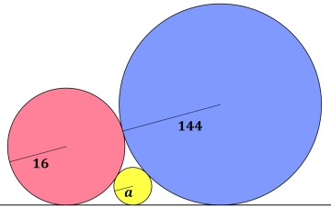
Three Circles and a Tangent
$$2\sqrt{bc}=2\sqrt{ab}+2\sqrt{ac}$$

Slide 9


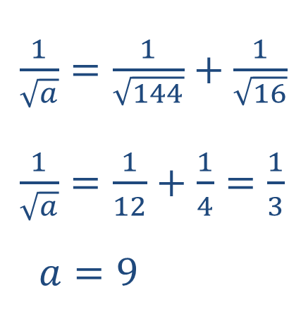

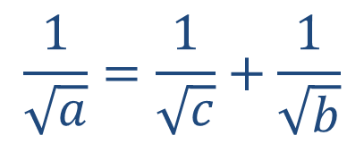
Three Circles and a Tangent
$$2\sqrt{bc}=2\sqrt{ab}+2\sqrt{ac}$$
$\sqrt{bc}=\sqrt{ab}+\sqrt{ac}$
$÷\sqrt{abc}$ both sides
$$\frac{1}{\sqrt{a}}=\frac{1}{\sqrt{c}}+\frac{1}{\sqrt{b}}$$
Returning to our problem:
$\frac{1}{\sqrt{a}}=\frac{1}{\sqrt{144}}+\frac{1}{\sqrt{16}}$
$\frac{1}{\sqrt{a}}=\frac{1}{12}+\frac{1}{4}=\frac{1}{3}$
$a=9$

Slide 10

Three Circles and a Tangent
$$\frac{1}{\sqrt{a}}=\frac{1}{\sqrt{b}}+\frac{1}{\sqrt{c}}$$
$$c$$
$$b$$
$$a$$

Slide 12

Note to Teacher
$a=9$ in all cases

Slide 13
RESOURCES

Slide 14


SIC_48
Three Circles and a Tangent
The three circles are touching and share a common tangent.
The radii of the two larger circles are as stated in the diagram
- all units are cm.
$$144$$
$$16$$
$$a$$
(Not to scale)
What is the value of the radius of the smallest circle, $a$?

Slide 15


SIC_48
Three Circles and a Tangent
The three circles are touching and share a common tangent.
The radii of the two larger circles are as stated in the diagram
- all units are cm.
$$2304$$
$$10.24$$
$$a$$
(Not to scale)
What is the value of the radius of the smallest circle, $a$?

Slide 16


SIC_48
Three Circles and a Tangent
The three circles are touching and share a common tangent.
The radii of the two larger circles are as stated in the diagram
- all units are cm.
$$650.25$$
$$11.56$$
$$a$$
(Not to scale)
What is the value of the radius of the smallest circle, $a$?

Slide 17


SIC_48
Three Circles and a Tangent
The three circles are touching and share a common tangent.
The radii of the two larger circles are as stated in the diagram
- all units are cm.
$$441$$
$$12.25$$
$$a$$
(Not to scale)
What is the value of the radius of the smallest circle, $a$?

Slide 18


SIC_48
Three Circles and a Tangent
The three circles are touching and share a common tangent.
The radii of the two larger circles are as stated in the diagram
- all units are cm.
$$203.0625$$
$$14.44$$
$$a$$
(Not to scale)
What is the value of the radius of the smallest circle, $a$?

Slide 19


SIC_48
Three Circles and a Tangent
The three circles are touching and share a common tangent.
The radii of the two larger circles are as stated in the diagram
- all units are cm.
$$110.25$$
$$17.64$$
$$a$$
(Not to scale)
What is the value of the radius of the smallest circle, $a$?

Slide 20


SIC_48
Three Circles and a Tangent
The three circles are touching and share a common tangent.
The radii of the two larger circles are as stated in the diagram
- all units are cm.
$$104.04$$
$$18.0625$$
$$a$$
(Not to scale)
What is the value of the radius of the smallest circle, $a$?

Slide 21


SIC_48
Three Circles and a Tangent
The three circles are touching and share a common tangent.
The radii of the two larger circles are as stated in the diagram
- all units are cm.
$$56.25$$
$$25$$
$$a$$
(Not to scale)
What is the value of the radius of the smallest circle, $a$?

Slide 22


SIC_48
Three Circles and a Tangent
The three circles are touching and share a common tangent.
The radii of the two larger circles are as stated in the diagram
- all units are cm.
$$43.56$$
$$30.25$$
$$a$$
(Not to scale)
What is the value of the radius of the smallest circle, $a$?

Slide 23


SIC_48
Three Circles and a Tangent
The three circles are touching and share a common tangent.
The radii of the two larger circles are as stated in the diagram
- all units are cm.
$$49$$
$$27.5625$$
$$a$$
(Not to scale)
What is the value of the radius of the smallest circle, $a$?

Slide 24


SIC_48
Three Circles and a Tangent
The three circles are touching and share a common tangent.
The radii of the two larger circles are as stated in the diagram
- all units are cm.
$$64$$
$$23.04$$
$$a$$
(Not to scale)
What is the value of the radius of the smallest circle, $a$?

Slide 25


SIC_48
Three Circles and a Tangent
The three circles are touching and share a common tangent.
The radii of the two larger circles are as stated in the diagram
- all units are cm.
$$81$$
$$20.25$$
$$a$$
(Not to scale)
What is the value of the radius of the smallest circle, $a$?

Slide 26


SIC_48
Three Circles and a Tangent
The three circles are touching and share a common tangent.
The radii of the two larger circles are as stated in the diagram
- all units are cm.
$$169$$
$$15.21$$
$$a$$
(Not to scale)
What is the value of the radius of the smallest circle, $a$?

Slide 27


SIC_48
Three Circles and a Tangent
The three circles are touching and share a common tangent.
The radii of the two larger circles are as stated in the diagram
- all units are cm.
$$225$$
$$14.0625$$
$$a$$
(Not to scale)
What is the value of the radius of the smallest circle, $a$?

Slide 28


SIC_48
Three Circles and a Tangent
The three circles are touching and share a common tangent.
The radii of the two larger circles are as stated in the diagram
- all units are cm.
$$324$$
$$12.96$$
$$a$$
(Not to scale)
What is the value of the radius of the smallest circle, $a$?

Slide 29


SIC_48
Three Circles and a Tangent
The three circles are touching and share a common tangent.
The radii of the two larger circles are as stated in the diagram
- all units are cm.
$$1521$$
$$10.5625$$
$$a$$
(Not to scale)
What is the value of the radius of the smallest circle, $a$?

